Slide 1
Milestone 2 Progress
Group:
Nicolas Rincon-Speranza
Lawson Darrow
Nikiraj Konwar
Christian Stevens
Advisor:
Dr. Zahra Nematzadeh

Slide 2
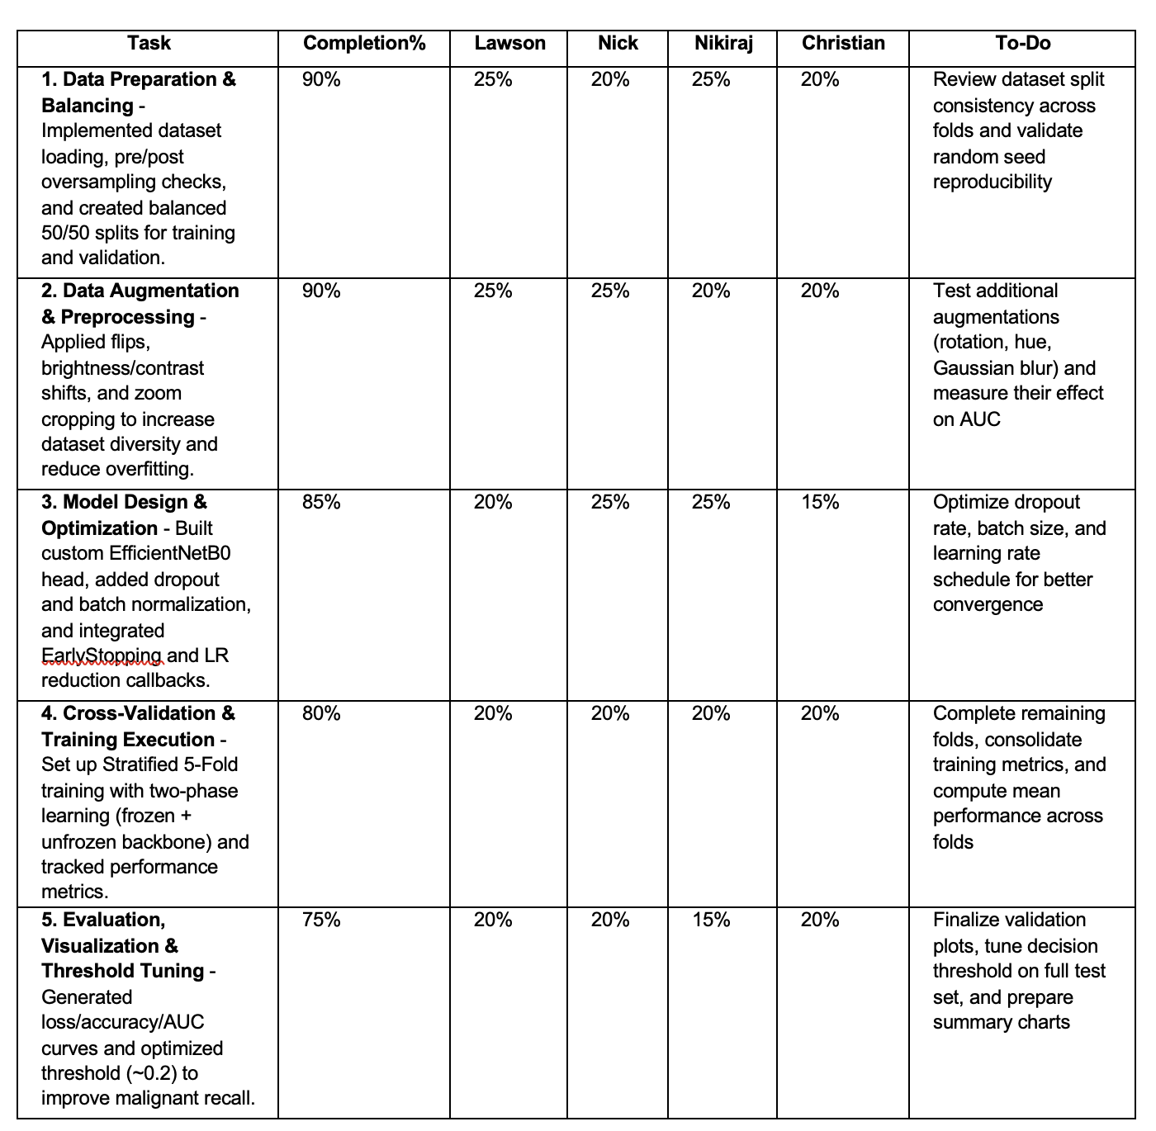

Slide 3
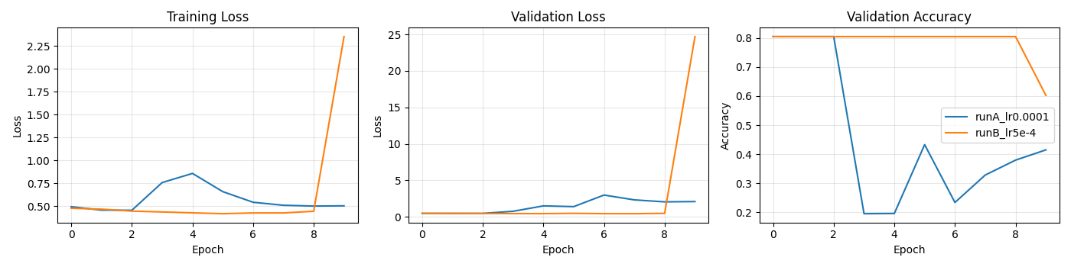
Before any changes

Slide 4

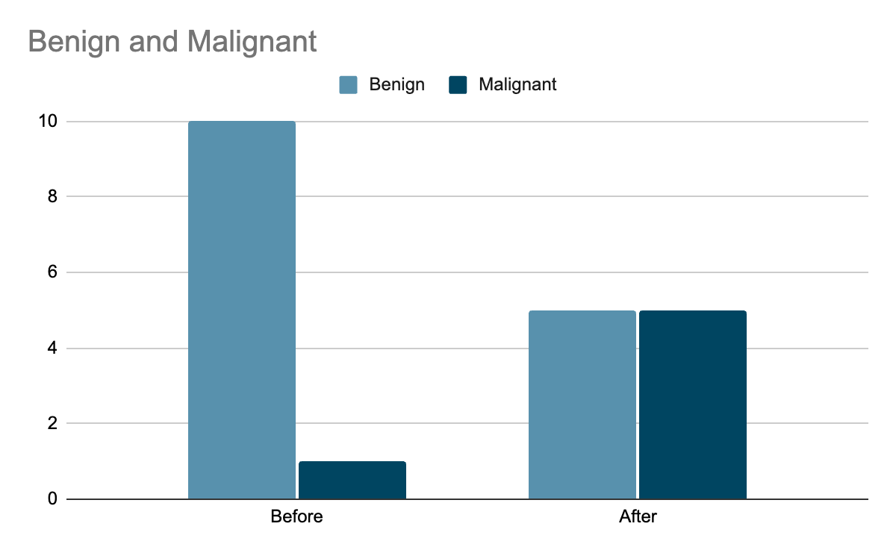
Fixing Class Imbalance
Original dataset: mostly benign images → model ignored malignant class
Added balanced sampling (50% benign / 50% malignant per batch) after augmentation.
Each malignant image reused with random flips, brightness, and zoom (augmentation).
Result: Model sees both classes equally → AUC improved from ~0.5 → ~0.85.

Slide 5

Augmentation
Applied to duplicates after oversampling data
Function applies random horizontal and vertical flips, brightness shifts, and resizing
Simulates rotation, lighting, and scale changes
So each training batch contains an equal amount of different benign and malignant images

Slide 6
Smarter Training with Transfer Learning
Used EfficientNetB0 pretrained on ImageNet for feature extraction.
Two-phase training:
Phase 1 – Warm-up (freeze backbone, train head, LR = 1e-3).
Phase 2 – Fine-tune (unfreeze all, LR = 1e-5).
Added EarlyStopping & ReduceLROnPlateau to stabilize training.
Result: Smooth convergence, validation accuracy ≈ 0.83, consistent AUC ≈ 0.85.

Slide 7
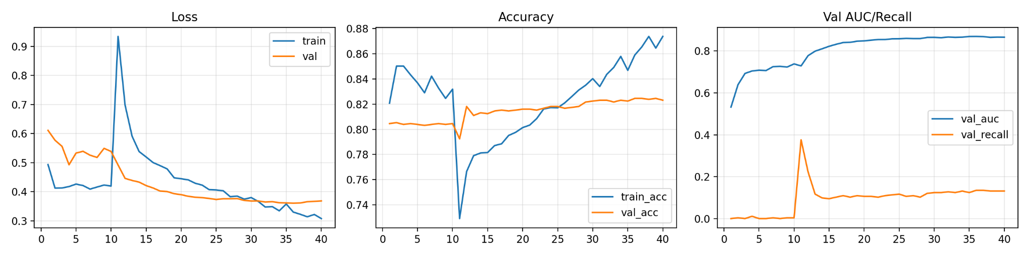
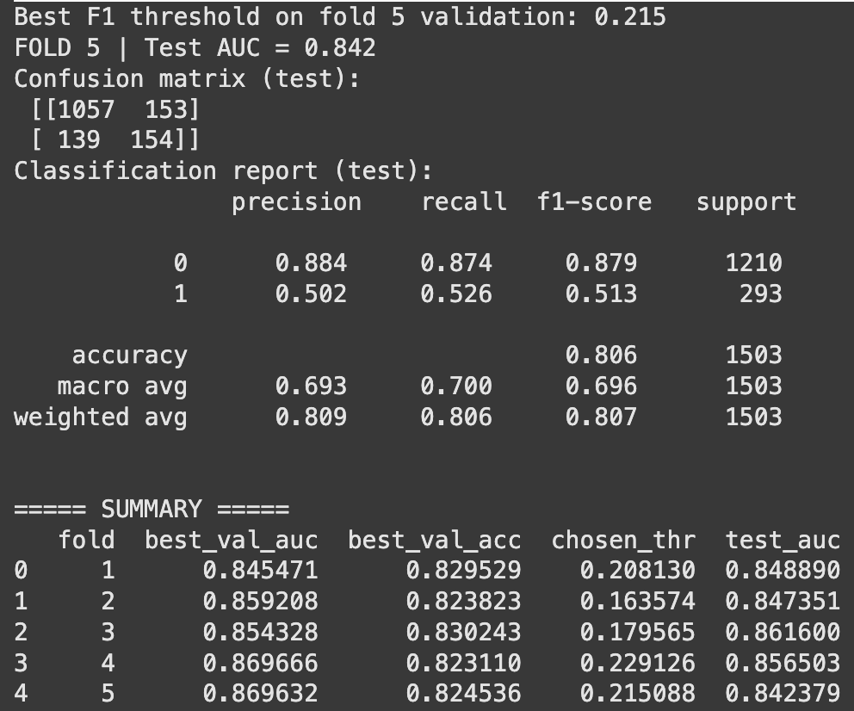
Reliable Evaluation & Interpretation
Implemented 5-Fold Cross-Validation for consistent results.
Added automatic threshold tuning (best F1 ≈ 0.20) for better recall.
Output detailed logs, learning curves, and CSV summaries for transparency.
Result: Consistent metrics across folds – AUC ≈ 0.85 ± 0.01, Accuracy ≈ 0.83

Slide 8
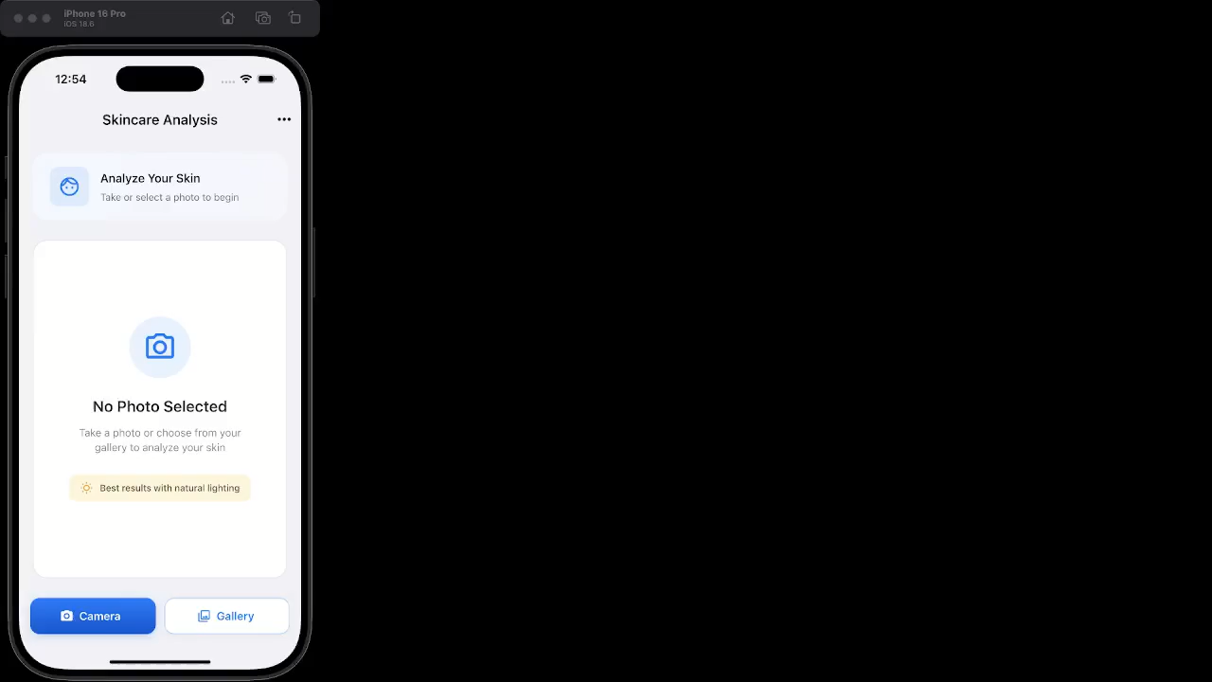
Mobile-App Demo v2
New menu feature
User settings
App version info
Medical disclaimers
Export function
History

Slide 9
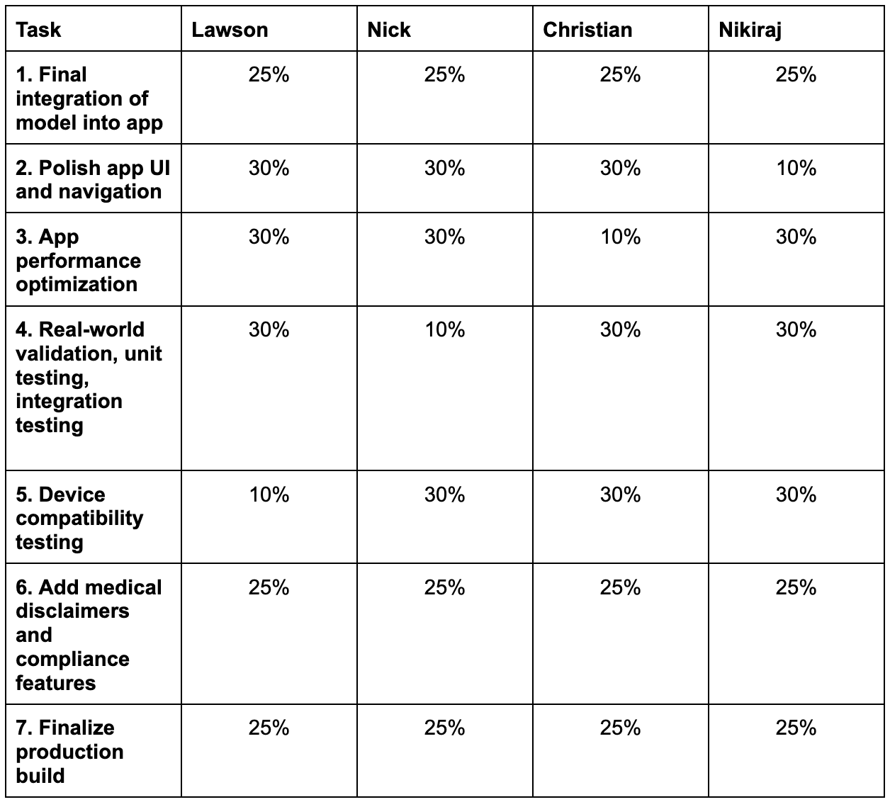

Slide 10
Thank you!
Any Questions

